Slide 1
Next Popular
YouTube virality predictor

Slide 2
Architecture
https://nextpopular.com
Video Information
URL
CSV
YouTube Rest API
Prediction
ML Models
Notes:
I was responsible for this ML pipeline

Slide 3
Architecture
https://nextpopular.com
Video Information
URL
CSV
YouTube Rest API
Prediction
ML Models
Notes:
I was responsible for this ML pipeline

Slide 4
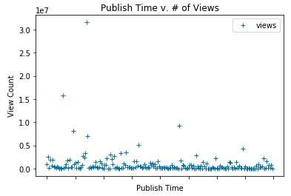
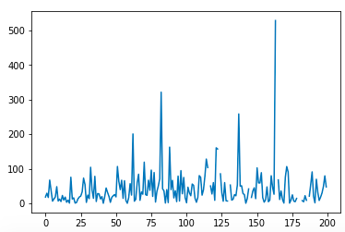
Individual Contribution / Demo

Slide 5
Next Steps
Clean the data in a better way
Improve Model
Create a model based on different features (string based)
Include training data that includes non-viral videos
Use more optimized labels for classifying views and other features
Work into getting the model connected with service or through GCP/AWS
Provide better feedback to user on categories and features that might provide insight

Slide 6
Questions?

